Slide 1






ARTIFICIAL INTELLIGENCE
TIME SERIES
By PinPin

Slide 2

INTRODUCTION
With the Stock market always growing, its hard to predict the actual prices to make the most profit and investment in the stocks. Investors may use stock price predictions to implement hedging strategies to offset potential losses.
Data Used
This is a dataset collected from the stock price of Apple, Amazon and DBS.
The dataset consists of the closing price of the 3 Companies

Slide 3

TABLE OF CONTENTS
01
02
03
04
Dataset Exploration
Dataset Processing
Model Selection
Model Improvement

Slide 4



DATA DICTIONARY
Name | Data Type | Description
Date | Date Time | Date Range from 2018 - 2023
Apple | Numeric | Closing Stock Price (Apple)
Amazon | Numeric | Closing Stock Price (Amazon)
DBS | Numeric | Closing Stock Price (DBS)

Slide 5
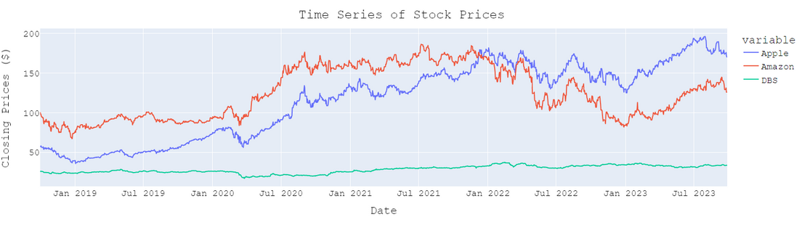
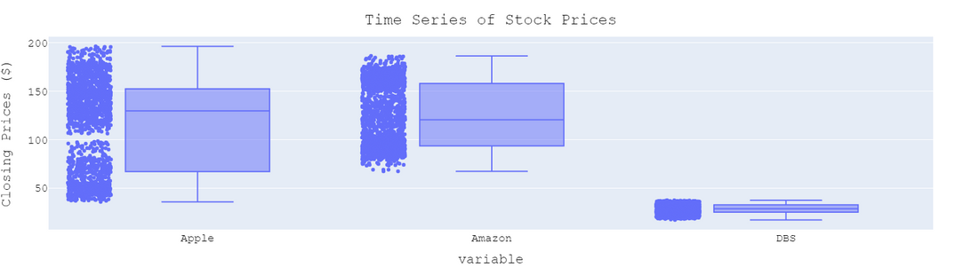
DATA EXPLORATION
Functions Used
Line Plot
df.shape
df.info()
df.describe()
df.isna().sum()
Boxplot
In our Dataset, we have:
4 Features
Shape = (1824, 3)
Datetime Frequency (Day)

Slide 6
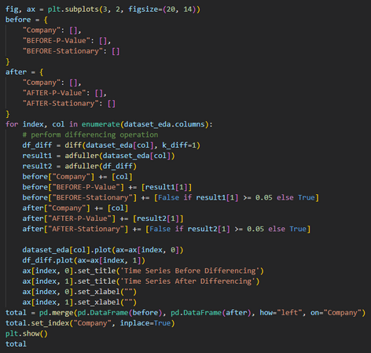
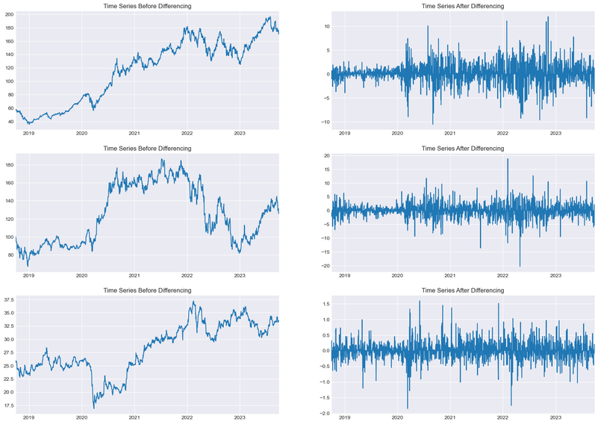
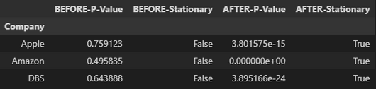
AUGMENTED DICKY FULLER TEST
Let H0 be Data is not stationary
Let H1 be Data is stationary
P-value > 0.05: Fail to reject the null hypothesis (H0), the data has a unit root and is non-stationary.
P-value <= 0.05: Reject the null hypothesis (H0), the data does not have a unit root and is stationary.

Slide 7
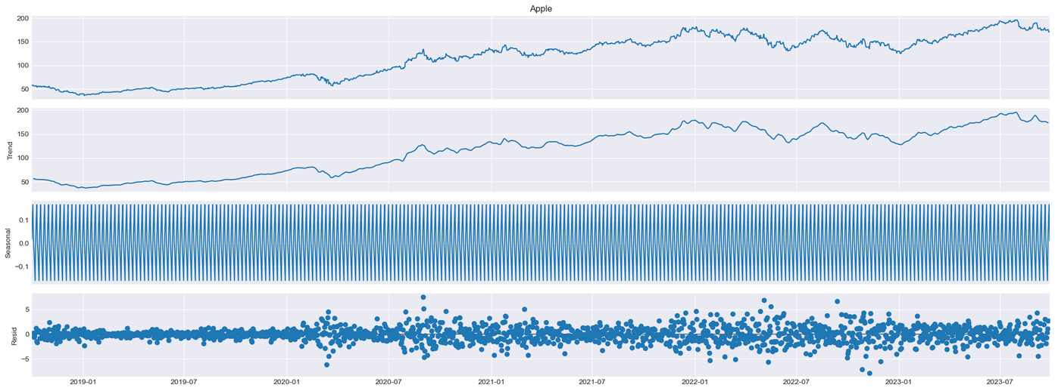
SEASONAL DECOMPOSITION
Time Series is made up of a Sum or Product of three components
Linear Trend
Seasonal Component
Random Residuals.
Seasonal = 7

Slide 8
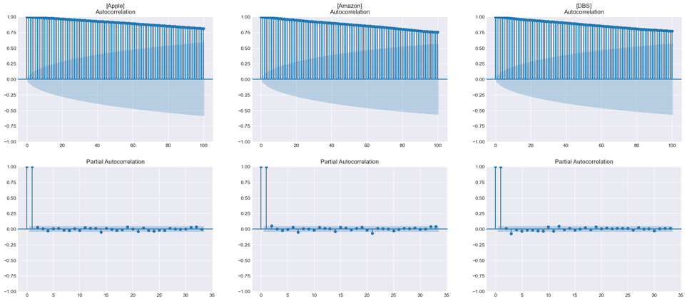
AUTOCORRELATION ANALYSIS
Autocorrelation (ACF)
the degree of correlation of the same variables between two successive time intervals (lagged version).
Partial Autocorrelation (PACF)
the degree of correlation of the same variables between two successive time intervals (lagged version) excluding the contributions from intermediate lags
ACF & PACF are very important in finding (p, d, q) for Autoregressive (AR) and Moving Average (MA) models
Autocorrelation Function:
Slow decaying ACF, we are likely dealing with an Auto Regressive Process
if Strong lines then sudden drop = Moving average
Partial Autocorrelation Function:
PACF We should start our Auto Regressive model with lag 1

Slide 9



DATASET
PROCESSING

Slide 10
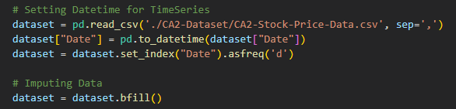
MISSING DATA
NA values
How to Handle:
drop df.dropna(subset=)
Imputation - replace with educated guesses
SimpleImputer: mean | median | mode
IterativeImputer: creates Regression model to guess
KNNImputer: take nearest features thats not NA
BackFill / FrontFill
Since we change the date frequency to “Day”, there are some null values. Hence, we use BackFill or FrontFill in order to get the previous stock price. This is more accurate as when we have null values, the stock market closes and doesn’t change.

Slide 11
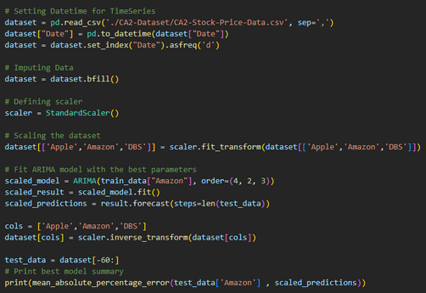
SCALING DATA
Increasing | Decreasing values
Methods
Standardization
the mean and divide by variance
features centered to 0 & variance = 1
Normalization
data ranges from -1 to +1
We shouldn’t use Normalization because time series doesn’t have any bound. Hence, we need to use Standardization
However, the MAPE value is still the same.

Slide 12
MODEL
SELECTION

Slide 13






SCORING METHODS
MSE
R²
MAE
Mean Squared Error
is the average squared difference between the estimated values and the actual value
Coefficient of determination
-∞ <X < 1
R² = 0 (Predicted Mean)
R² = 1 (Predicted Exact)
Mean Absolute Error
error between paired observations expressing the same phenomenon

Slide 14
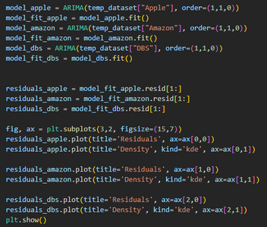

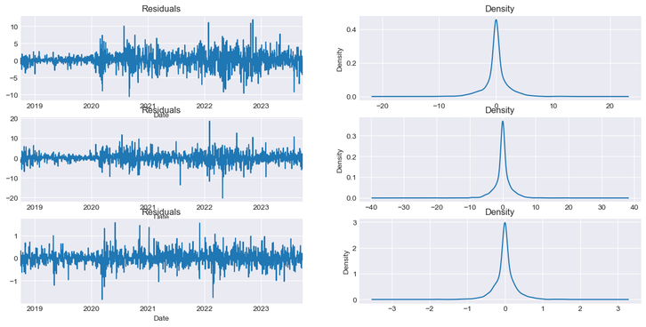
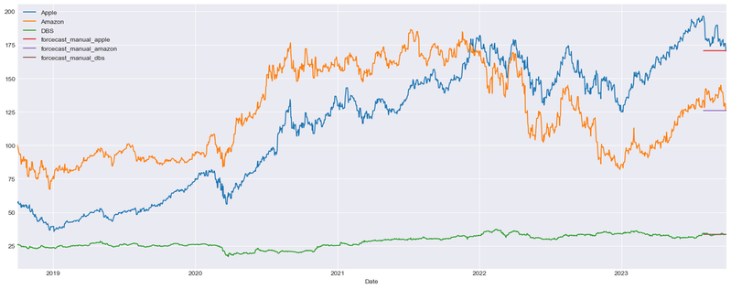
BASELINE
ARIMA - order(1,1,0)
Autocorrelation Analysis:
it gives us the value of P = 1
Augmented Dicky Fuller Test:
it tells us that it needs a difference of 1

Slide 15
MODEL
IMPROVEMENT

Slide 16
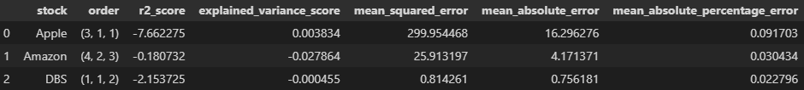

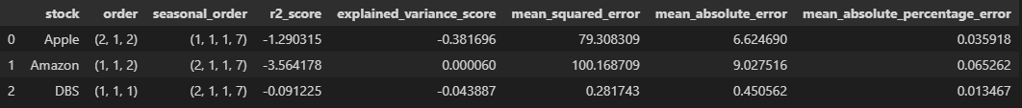
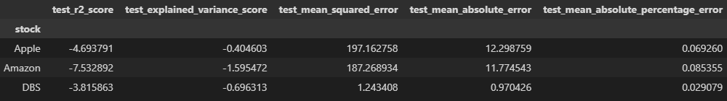
CHOOSING MODEL
Grid Search to test all combinations of the Model
ARIMA
SARIMA
Holt Winter's Exponential Smoothing

Slide 17
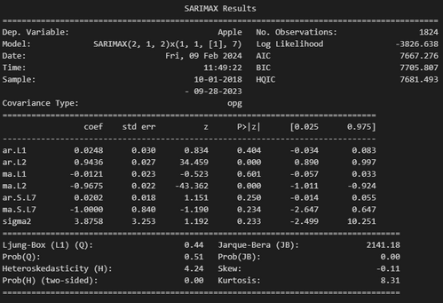
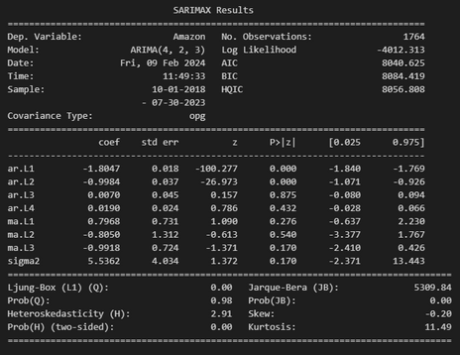
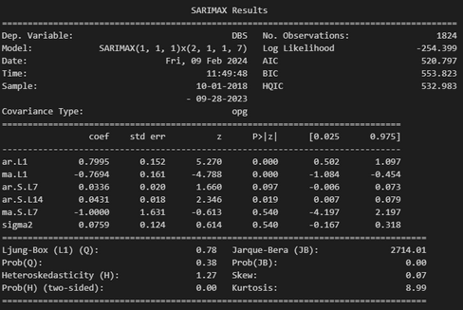
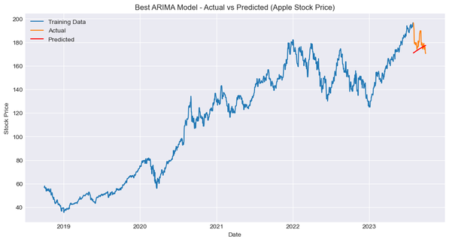
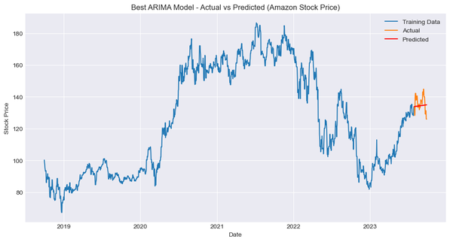
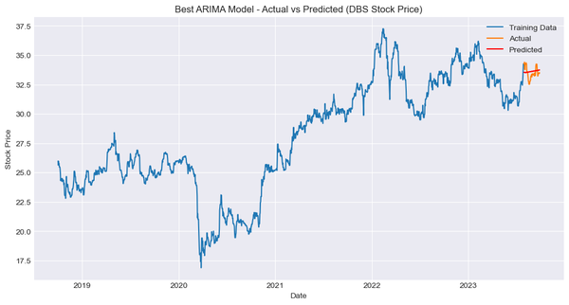
BEST MODELS
Apple
Amazon
DBS

Slide 18






CONCLUSION
Best Models:
Apple (SARIMAX = (2, 1, 2),(1, 1, 1, 7))
Amazon (ARIMA = (4, 2, 3))
DBS (SARIMAX = (1, 1, 1),(2, 1, 1, 7))
Learning insides:
scaling doesn't affect the model
Best Model is SARIMAX, but takes the longest
Our Dataset is Non seasonal (seasonal = 7)

Slide 19

THANK YOU!

